Slide 1
2020 OEM Parts rebranding
- update and actions -
01/13/2020
Alan Heaton
David Klepperich
Martin Soderlund

Slide 2
Martin
Agenda
Reason for Action
How we got here
Future State
OEM Value Proposition
We are more than OEM: SF Value focused Aftermarket parts
SF product offering and timeline of introduction
Marketing material / In-store execution
How to communicate with customers
Next Steps

Slide 3
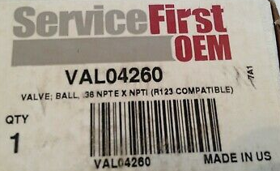
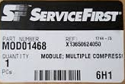
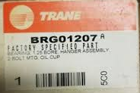
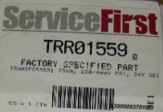
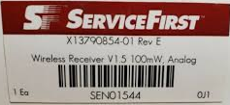
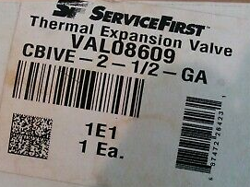
Martin
OEM Parts rebranding: Reason for Action
  Reason for Action
  We are missing out of an opportunity to drive home the value of OEM Parts due to:
    Our inconsistent parts branding & labeling
    Lack of a meaningful OEM brand
    Lack of a clear OEM value proposition
    Significant confusion between ServiceFirst OEM
    and SF (our value brand)

Slide 4
Martin
OEM Parts rebranding: How we got here
  Methodology
  We started with a quantitative study to understand current brand perceptions, as well as challenges and considerations, for our part brands to help inform the best Naming and Brand Identity
    Sample Size 338 / Distributed nationwide / Mix of frequent and infrequent customers
  Our research partners conducted multiple store visits to get a new point of view of current state
  We combined the above with the project team learnings from customer and store visits
  Once we had a recommendation, it was vetted with representatives from our Trane Supply stores and our Independent partners
  Does OEM Parts branding really matter?
  Only if it has a meaning
  “…the customers don’t really pay any attention to the branding…the exception is when it says Trane or American Standard…That they understand...”

Slide 5
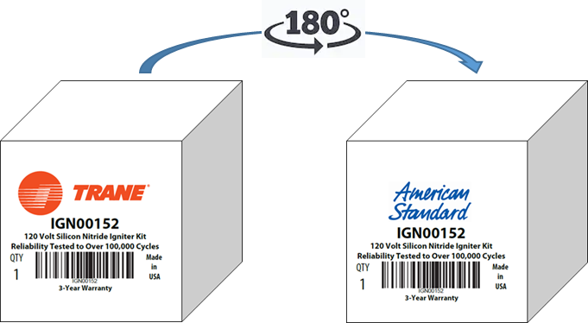
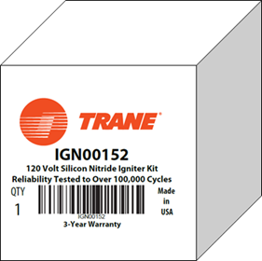
Martin
OEM Parts rebranding: Future State
  Moving away from ServiceFirst OEM
  We are moving away from the ServiceFirst OEM brand and will replace it with our Trane and American Standard equipment brands
    Parts used in both Trane and American Standard equipment will be dual branded
    RunTru parts will be Trane branded
    Ameristar parts will be American Standard branded
  It will be a soft roll-over starting in 2020. No part number changes. We expect to have a mix of old and new for some time until the old inventory has been depleted
Current State
Future State
Trane only Equipment
Trane & American Standard Equipment
Single branded packaging: One side with Trane label
Dual branded packaging: One side with Trane label and One side with American Standard label

Slide 6
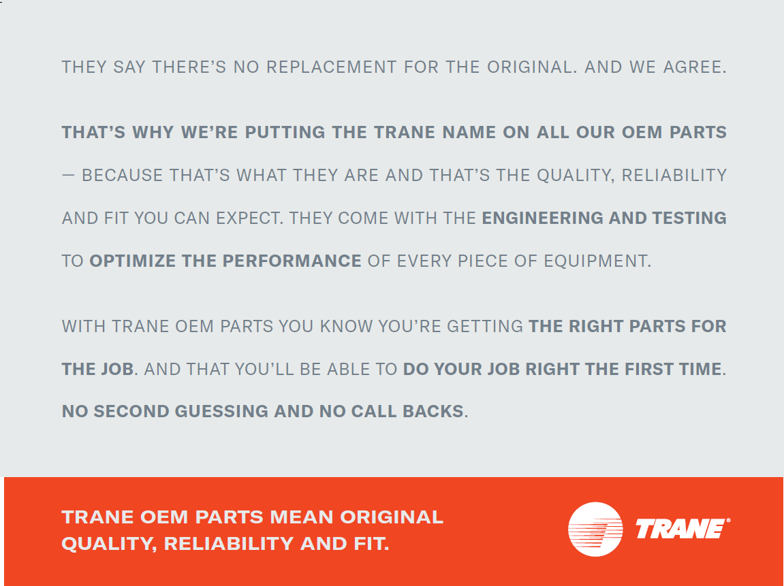
Martin
OEM Parts rebranding: OEM Value Proposition
  OEM matters
  With the new branding in place, how do we ensure we have a clear OEM value proposition?
  Trane OEM parts mean original quality, reliability and fit

Slide 7
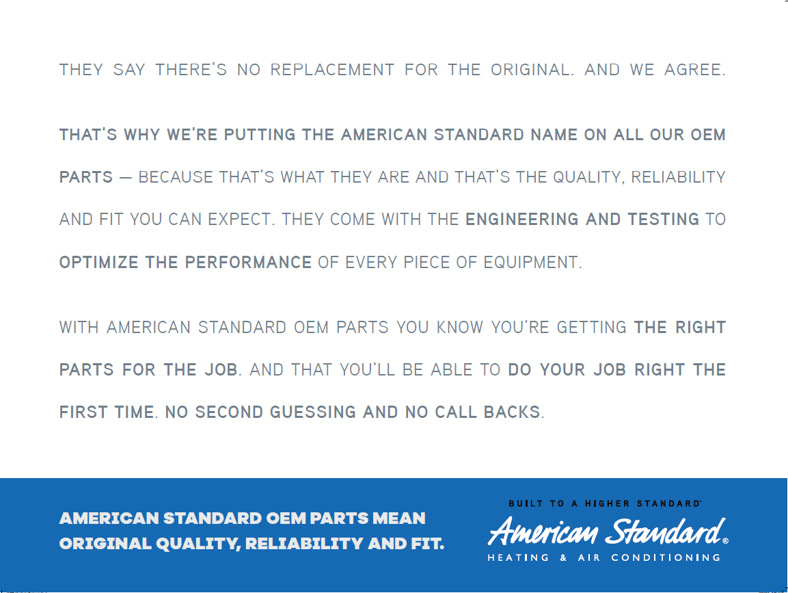
Martin
OEM Parts rebranding: OEM Value Proposition
  OEM matters
  With the new branding in place, how do we ensure we have a clear OEM value proposition?
  American Standard OEM parts mean original quality, reliability and fit

Slide 8
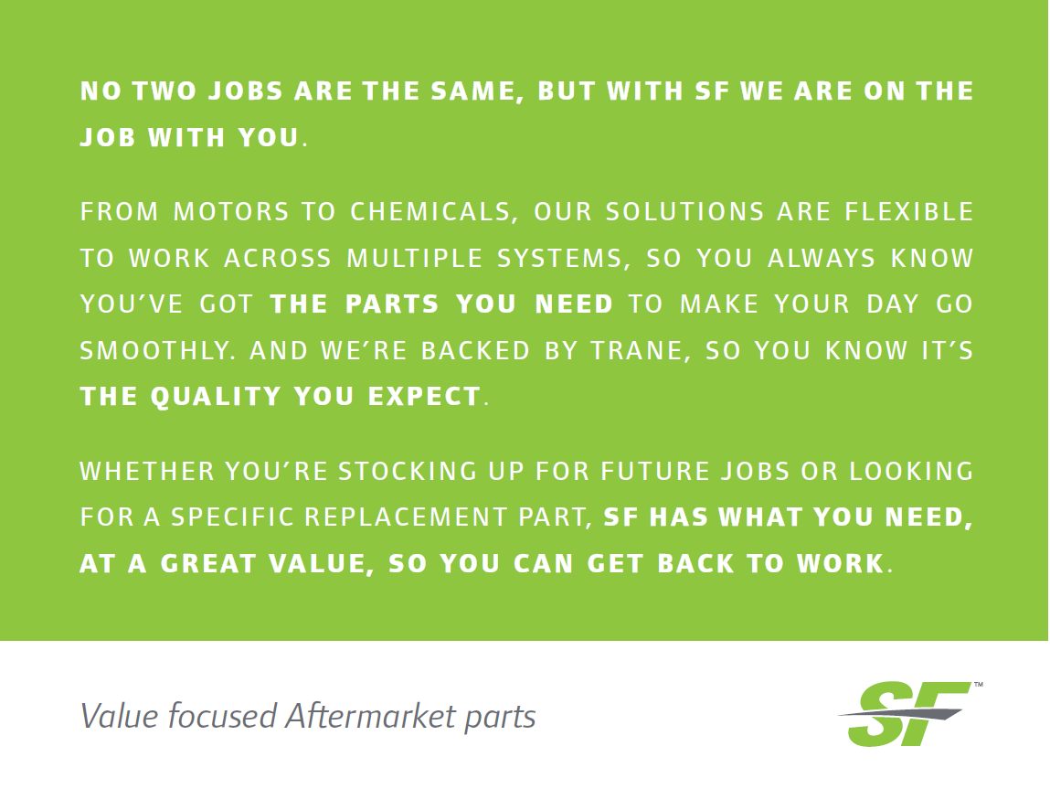
Martin
We are more than OEM: SF Value focused Aftermarket parts
  OEM matters
Our SF brand has been around for a number of years, sold mostly through the Trane Supply stores
We have expanded our SF offering over the years
SF is all about “Value focused Aftermarket parts” to complement our OEM offering and reach a broader set of customers and their needs

Slide 9
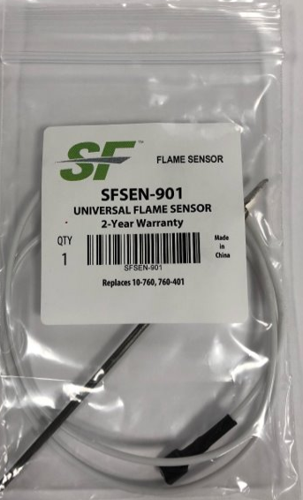
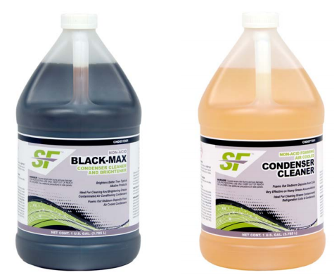
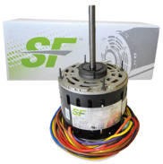
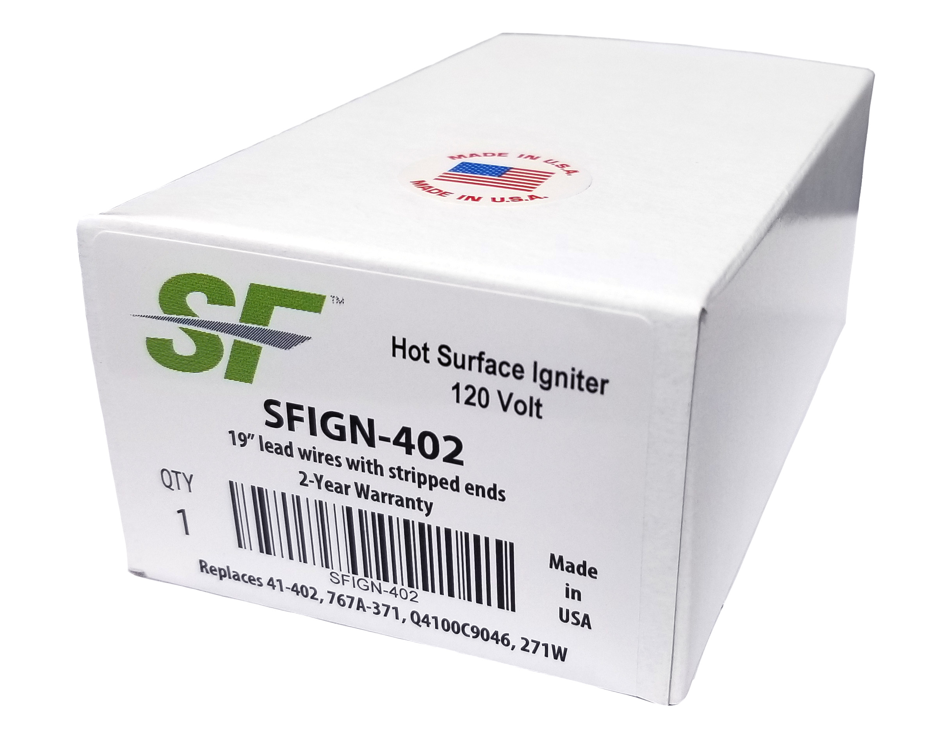
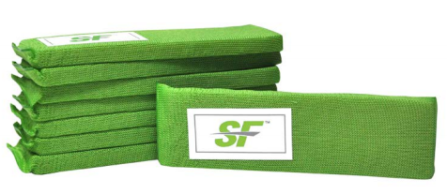
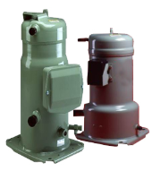
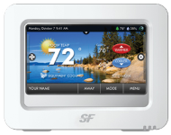
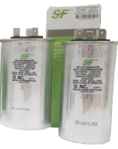
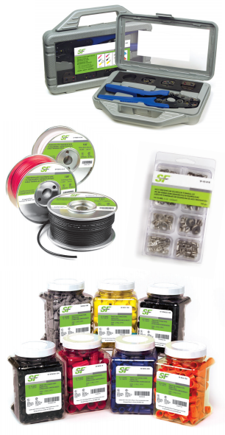
Martin
SF product offering and timeline of introduction
Flame Sensors
Chemicals
Motors
Pan Treatment
Igniters
2014
2015
2020+
2016
2017
2018
2019
Transformers
Scroll
Compressors
Contactors
Aux Switches
Thermostats
Relays
Capacitors
Wiring and Installation Accessories

Slide 10
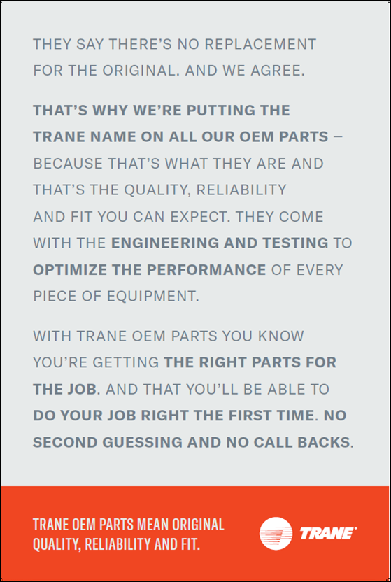
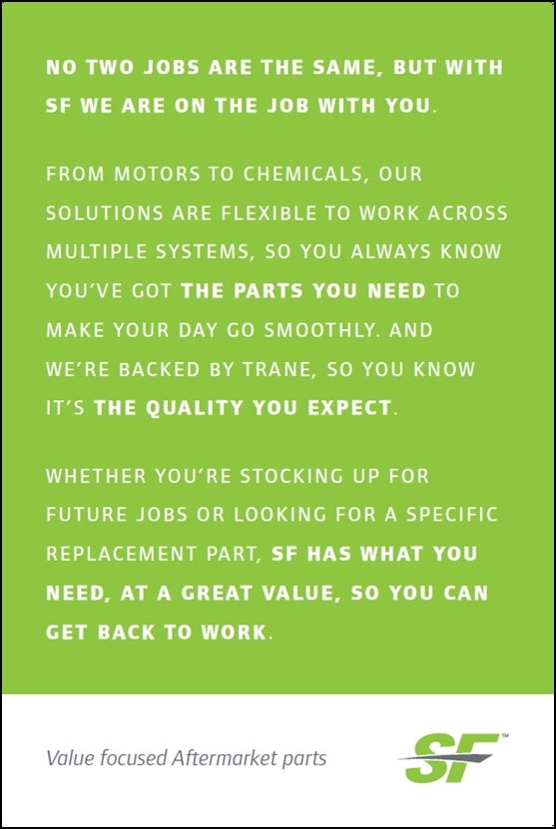

Dave
Marketing material / In-store execution
  Marketing Material
  Posters and double sided counter mat inserts will be sent out week of 1/13/20 and week of 1/20/20
  The posters should go in the frames already in store
  PDF versions of the value boards will be available on-line as well
  In-store re-labeling
  To enable in-store re-labeling, we will also send out color printed Trane labels
  The Trane labels will cover the Service First logo
  These are the two label sizes we have identified so far:
    MDC labeled items: 3.25 x 0.65
    Larger items: 4.40 x 1.20

Slide 11
Alan
How to communicate with customers
  Give Associates a better method to deliver and define the Value Propositions
  Use the counter mat inserts and/or print 8-1/2 x 11 copies of Value Propositions to hand out at the counter
    Sales Associates will deliver message to walk-in customers
    Sales Associates can obtain feedback from customers thru face to face interactions and dispel misconceptions perceptions and turn it into positive perceptions
  Account Managers will take copies of Value Propositions to Assigned Accounts
    Deliver message directly to customers
    Leverage to develop customer confidence
  Send PDF version of Value Propositions with email distribution materials
    Follow up calls to customer to deliver and define the message
    Opportunity to develop customer confidence

Slide 12
Martin
Next Steps
  Action Item
  Use your current poster frames and put up the new OEM and SF value posters in store
  Use the counter mat inserts and/or print 8-1/2 x 11 copies of Value Propositions to hand out at the counter
  On-Pack branding implementation plan
  Q1 2020: All suppliers currently branding our parts Service First to change to new branding structure
  Q1 2020: Implement changes to all parts currently branded Service First at our MDC to adopt the new branding structure
  Q1 2020: Kick-off project to re-brand current inventory at the MDC

